Slide 1
Team Import Stellar
Akshay Newgi
Carre Perkins
Jules Real
Sonny Desai
Shannon Li
Notes:
Akshay

Slide 2
The Proposal
Our team decided to tell the story of Global Warming. To do this, we created and interactive website & graphs to help visualize the story of global warming and to highlight the historical changes in the data.
We decided to focus on the following factors: global change in temperature, localized change in temperature, and change in CO2 levels. The rise of these three factors are integral to the story of the overall effects of global warming.
Notes:
Shannon

Slide 3
The Data
Our data came from several sources including the Commonwealth Scientific and Industrial Research Organisation, the US Department of Commerce's Earth Systems Research Laboratory Global Monitoring Division, and the National Aeronautics and Space Administration. Our data was collected from these scientific sources which have been collecting data on global warming for several decades to ensure a sufficient data size and minimize potential error.
We collected our data in a .csv format, imported that information to MySQL workbench, and connected that to the JawsDB Heroku add-on.
Notes:
Jules

Slide 4
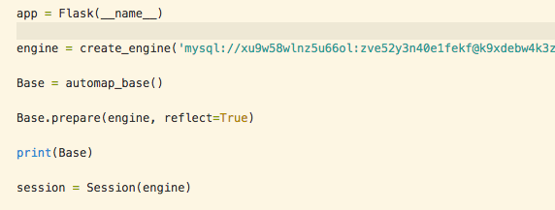
The Data
Notes:
Jules

Slide 5
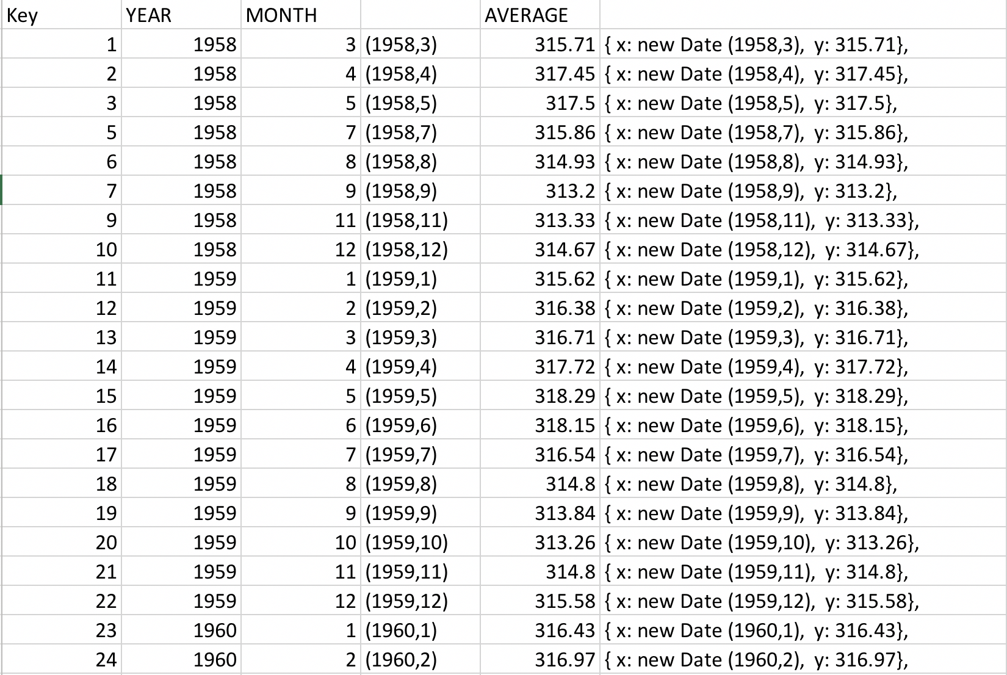
CO2 Data
Notes:
Akshay

Slide 6
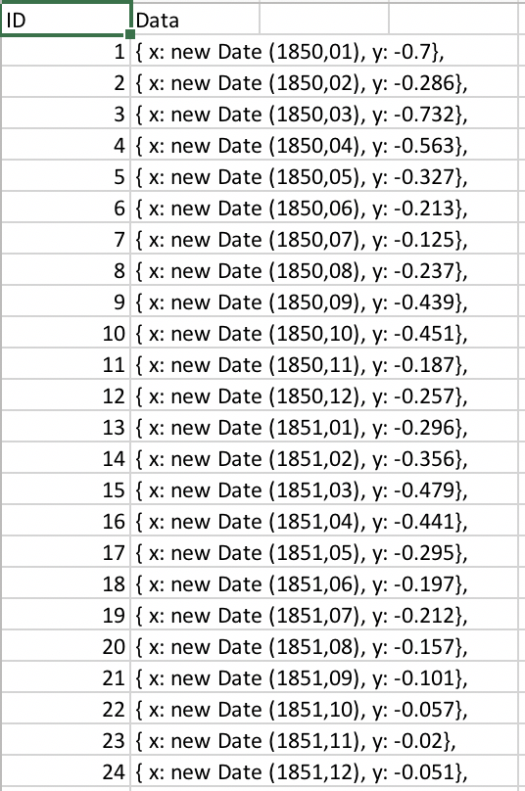
Temperature Data
Notes:
Akshay

Slide 7
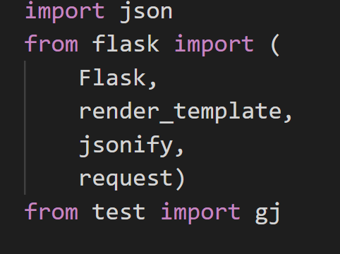
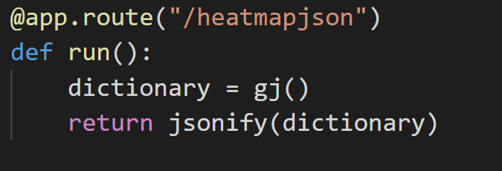
The Data
We pulled baseline/current weather data for random cities throughout the world using openweathermap. We cleaned the data and created a JSON file. The JSON was imported to our App.py was able to be called in a function (ie run()).
Notes:
Carre

Slide 8
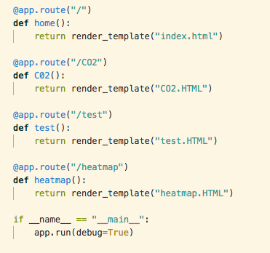
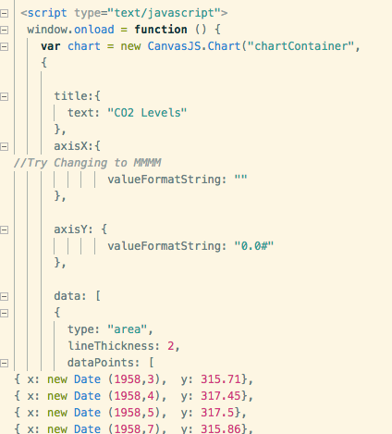
The Website
After successfully importing the data and utilizing it in our graphs, we included CSS, HTML, and JavaScript to create a stylized and functioning web page.
Notes:
Jules

Slide 9
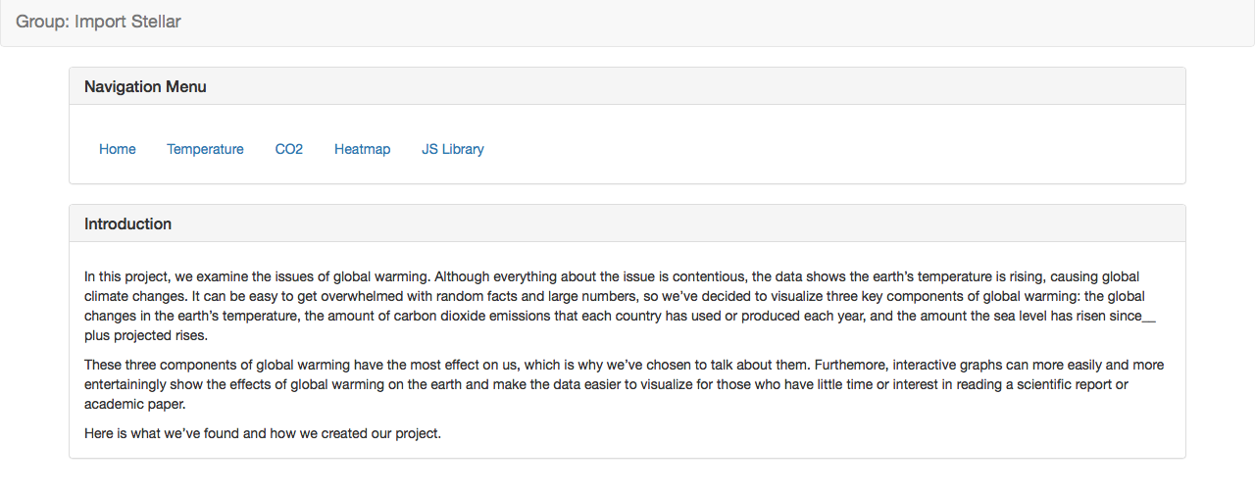
The Website
Notes:
Jules

Slide 10
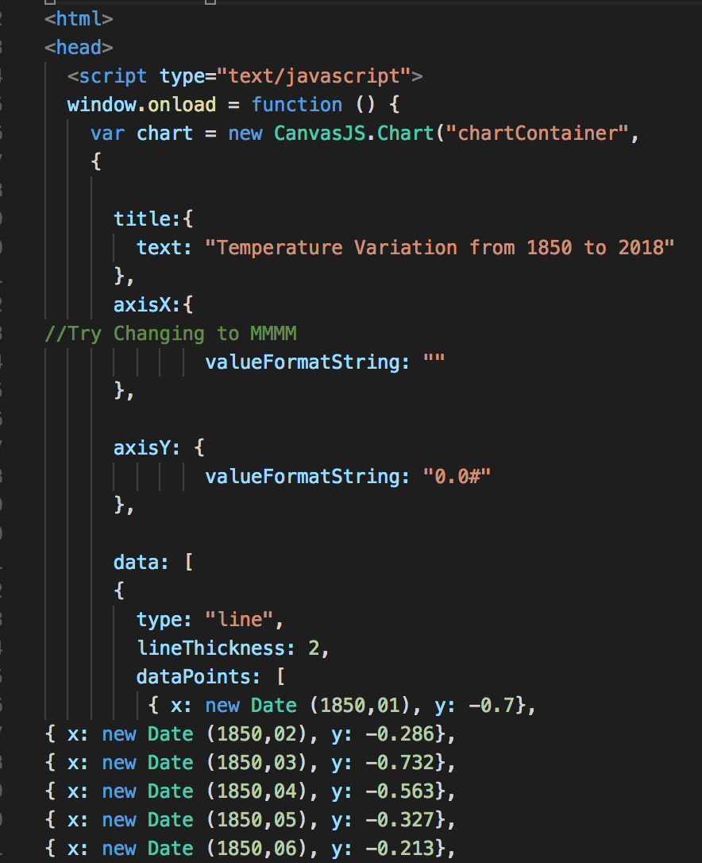
Code for Graph showing Temperature Variation between 1850 and 2018.
Notes:
Akshay

Slide 11
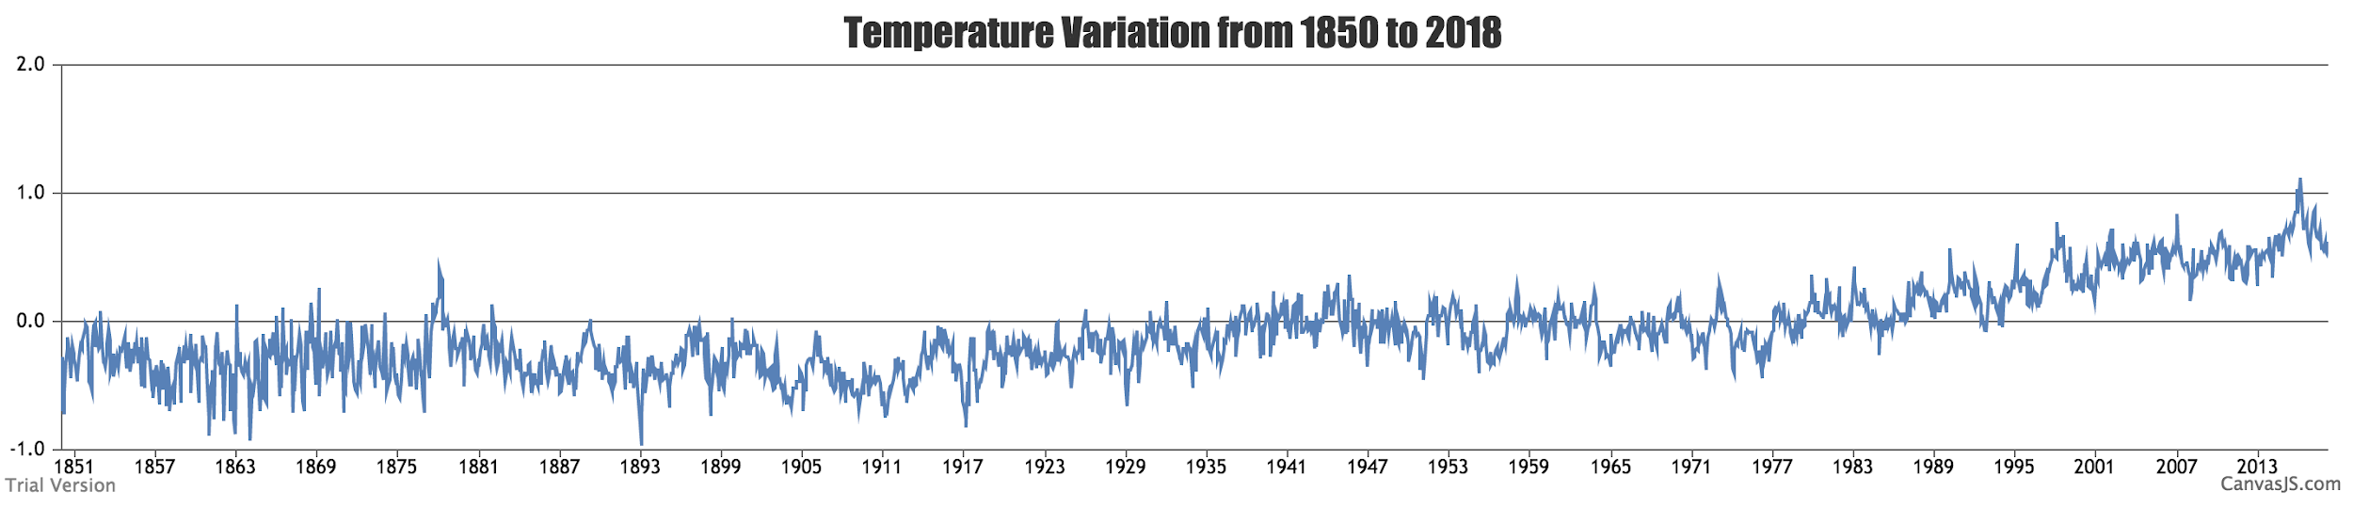
Temperature Variation from 1850 to 2018
Insert Picture 1
Notes:
Akshay

Slide 12
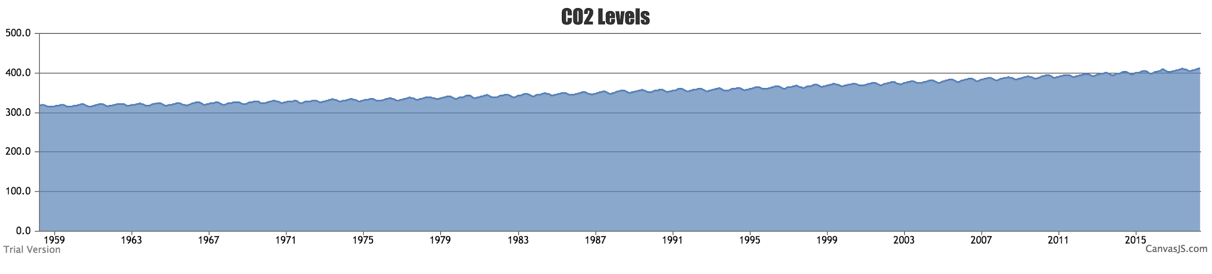
CO2 levels from 1959 to 2018
Insert Picture 2

Slide 13
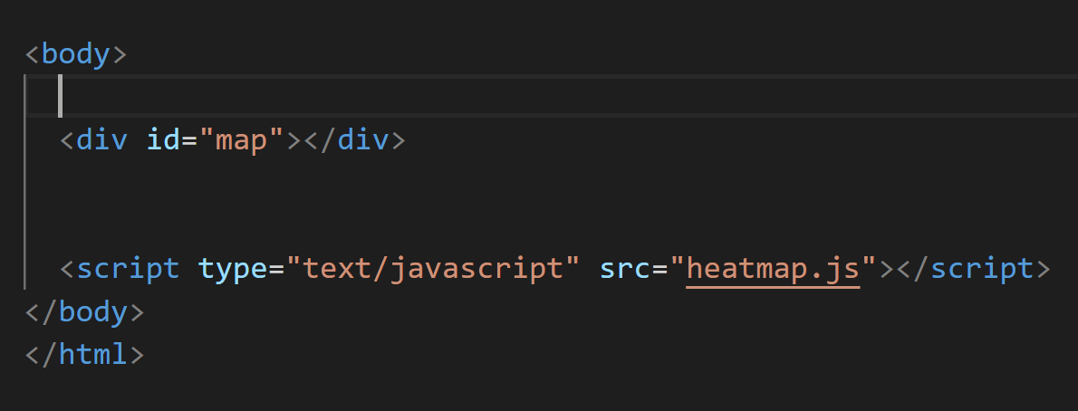
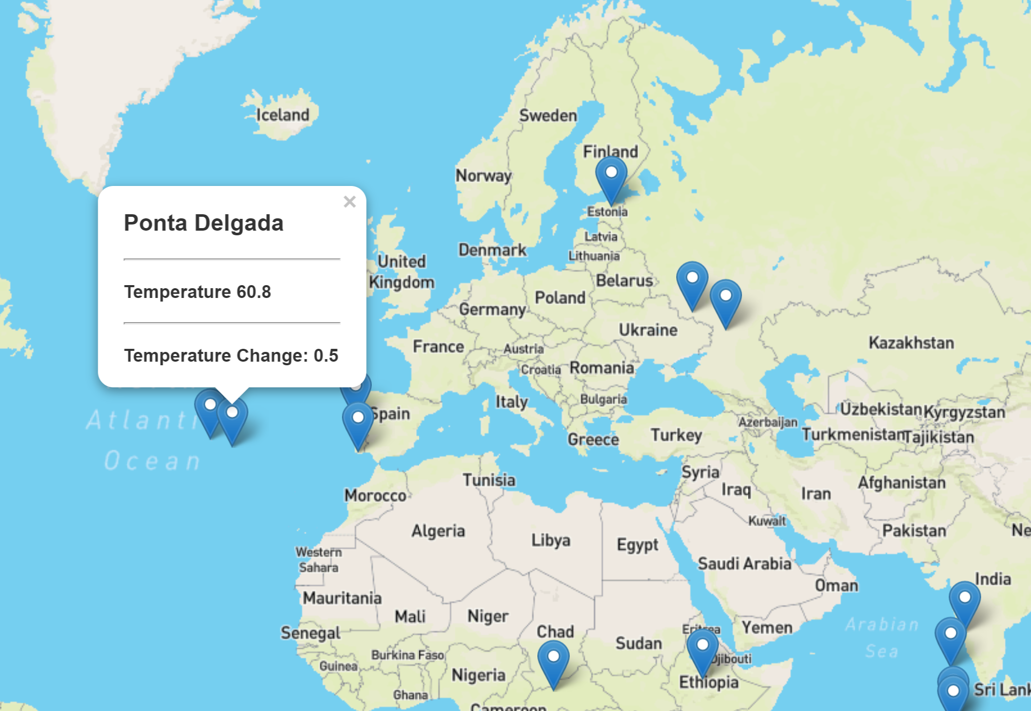
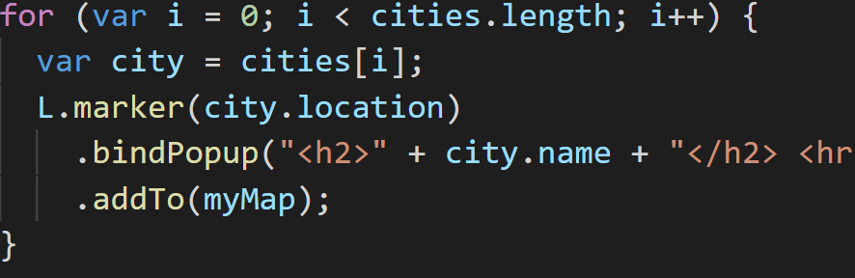
Global Temperatures
Notes:
Carre

Slide 14
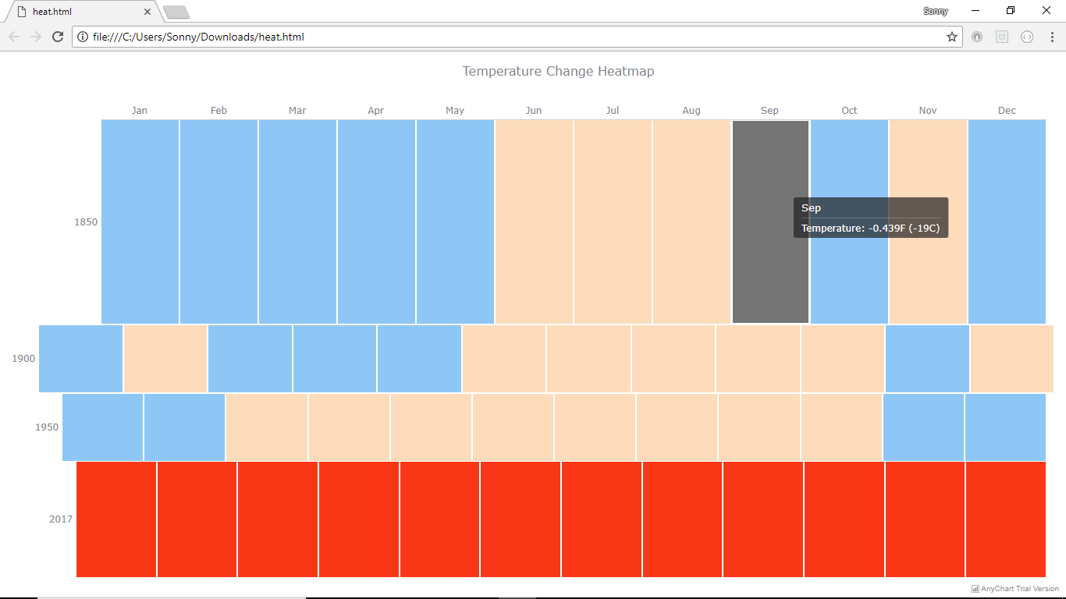
AnyApp Visualizations
JS Libraries:
Anychart
FusionChart
Highchart
Notes:
Sonny

Slide 15
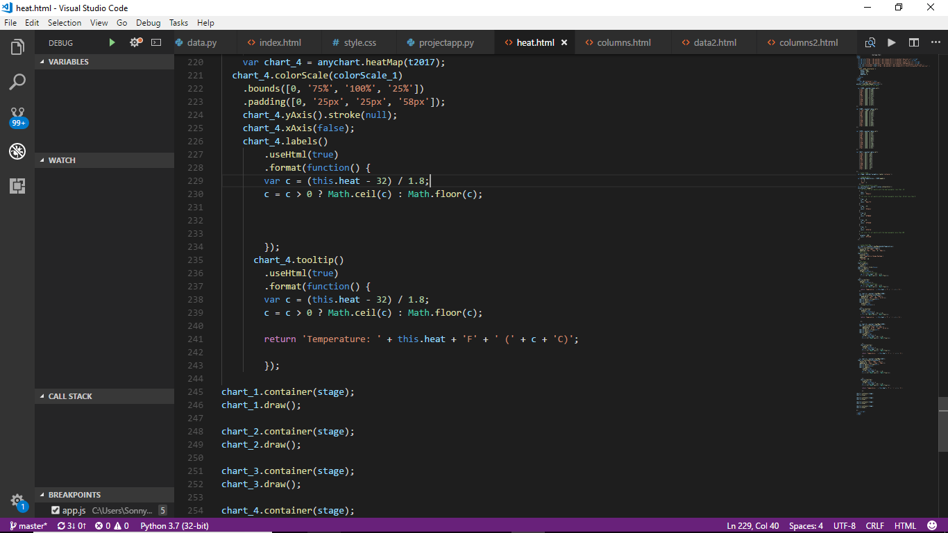
Demonstration
Notes:
Sonny

Slide 16
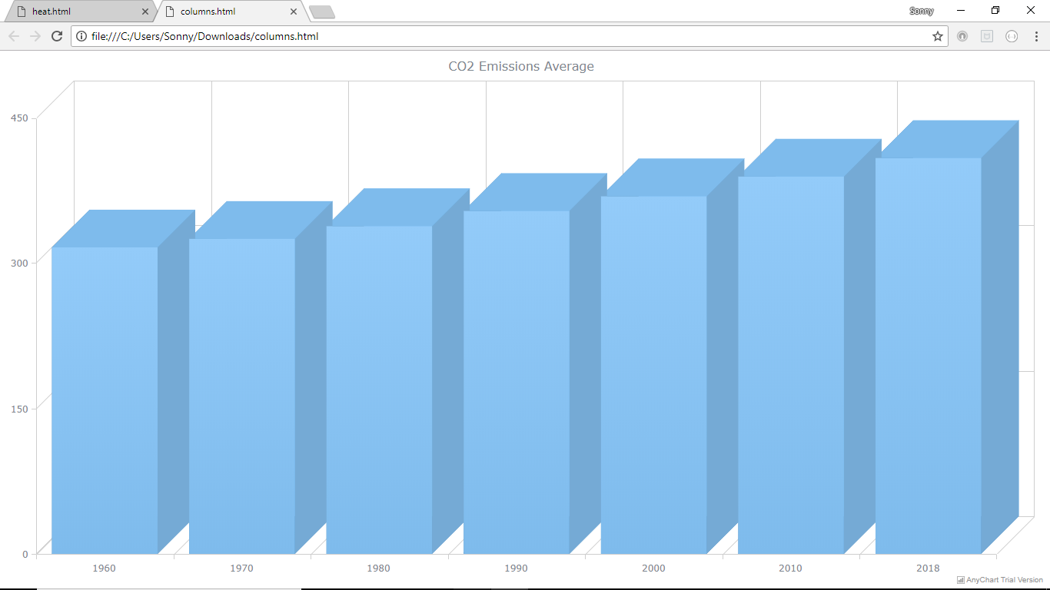
Notes:
Sonny

Slide 17
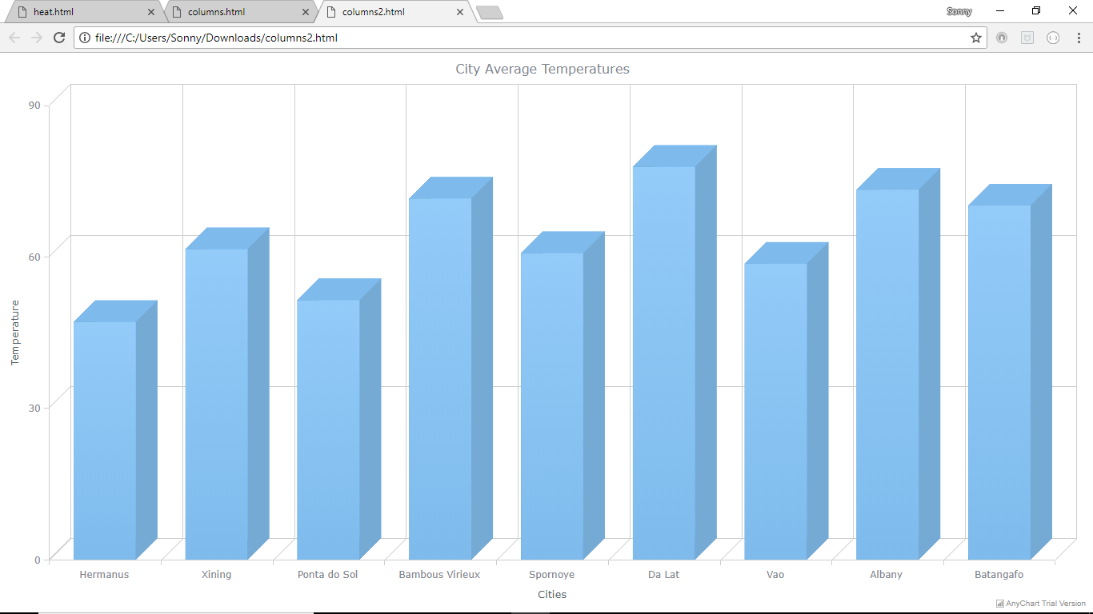

Slide 18
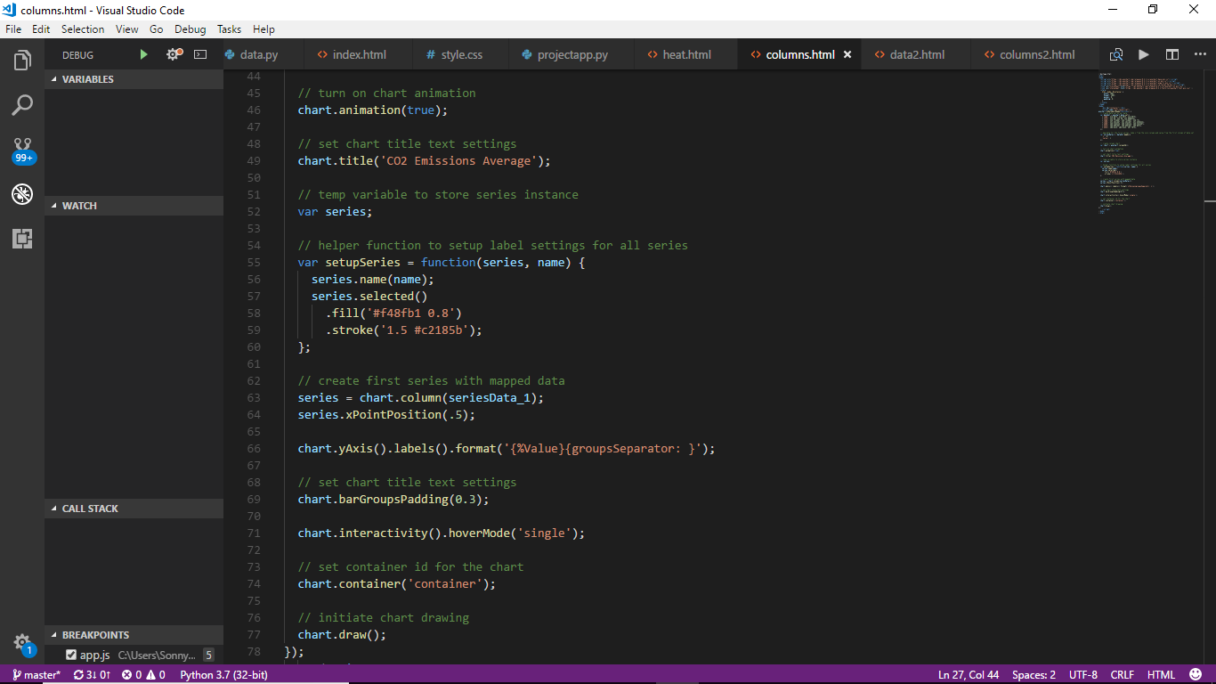

Slide 19
Concluding the Story
In conclusion, the story we found about Global Warming showed steady increases across all three of the factors we chose. CO2 levels rose consistently over a six decade span. Average temperatures rose in individual cities and the globe as a whole. Global temperatures rose to its highest levels since the data has been recorded, in the last year.
Notes:
Sonny

Slide 20
Thank You!

